Slide 1

Lesson01
Advantages of setting up an app

Slide 2
Introduction to design sprint
Advantages of setting up an app
Steps to design app
Introduction and grouping of topics at
the end of the course
http://fpt.edu.vn

Slide 3
Introduction to design sprint
Use design sprints to answer questions, define product directions, figure out cross-team strategies, and even build team culture.
Design sprints generally include five phases: understand, ideate, decide, prototype, and test. We'll come back to these phases and investigate each one later.
Before launching into a design sprint, you need to review your design challenge and ask yourself these key questions:
  Are there many potential solutions to your design challenge?
  Does a design challenge require people from cross-functional teams to weigh in?
  Is the design challenge's scope wide enough for a sprint?
http://fpt.edu.vn

Slide 4
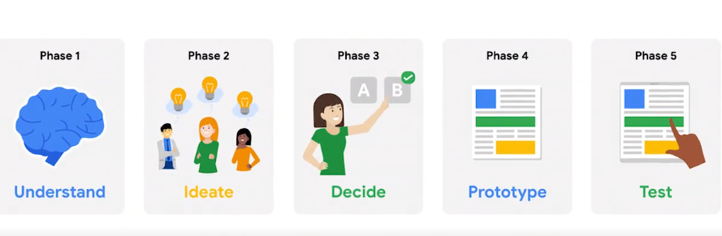
Five phases of design sprint
Understand: The team works to clearly define the design challenge by learning from experts, gathering insights, and engaging in discussions. The focus is on understanding the user's needs and goals.
Ideate: The team brainstorms and generates creative ideas to solve the design challenge. Everyone sketches and presents their ideas, and the team begins to plan for user testing in the next phase.
Decide: The team evaluates all the potential solutions and selects the one that is most likely to meet user needs and achieve the desired outcome.
Prototype: The team creates a realistic, functional prototype based on the chosen solution. The prototype is focused on what the user experiences and doesn't need to be a final product.
Test: The prototype is tested by real users, and their feedback is gathered. The team uses the insights from user testing to identify necessary changes before launching the product.
http://fpt.edu.vn

Slide 5
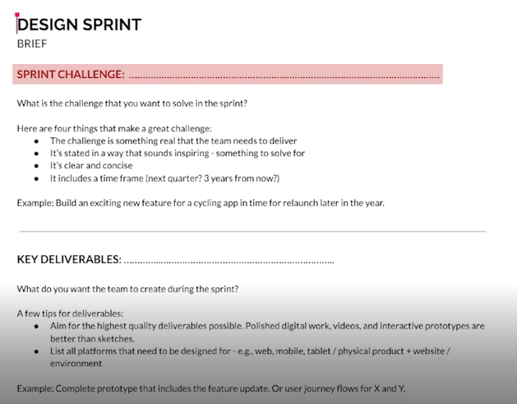
The design sprint brief
Here's a summary of the key elements of a design sprint brief:
Design Sprint Challenge: Introduces the sprint objectives and defines the problem to solve, such as building exciting new features for an app.
Key Deliverables: Outlines what the team aims to achieve by the end of the sprint, like having a complete prototype ready for the new feature.
Logistics: Details where and when the sprint will take place, who will attend, and the name of the sprint master (the person organizing the sprint).
Approvers: Lists any higher-ups that need to sign off on the product before it launches.
Resources: Identifies the resources (team members, tools, etc.) available for the sprint, and plans for securing additional resources if needed.
Project Overview: Provides context on the current state of the project, any roadblocks, early wins, and the estimated launch plan.
Sprint Schedule: An hour-by-hour breakdown of the five-day sprint, including break times, to help participants prepare and keep things on track.
With the brief complete, the design sprint is ready to begin!
http://fpt.edu.vn

Slide 6
Advantages of setting up an app
If you are a small business owner and your business does not have a mobile app, you need to get one. Having a web presence alone is no longer sufficient, as online activity continues to shift to mobile. Simply put, smartphone apps have become too important a marketing tool for small business owners to do without.The demand in mobile-phone usage means that smartphone apps have become a key marketing tool for companies of all sizes, including small businesses.
http://fpt.edu.vn

Slide 7
Advantages of setting up an app
Mobile apps increase engagement with customers. They boost repeat visits, and permit a wide variety of online transactions, including the deployment of loyalty cards, push promotions, and ecommerce transactions. Apps deliver coupons and send announcements that build your sales with customers. Apps also accelerate contact with your company, which enhances relationships with customers in a world where speedy responses are prized by buyers. Smartphone icons even help build brands by providing a visual design that customers recognize.
http://fpt.edu.vn

Slide 8
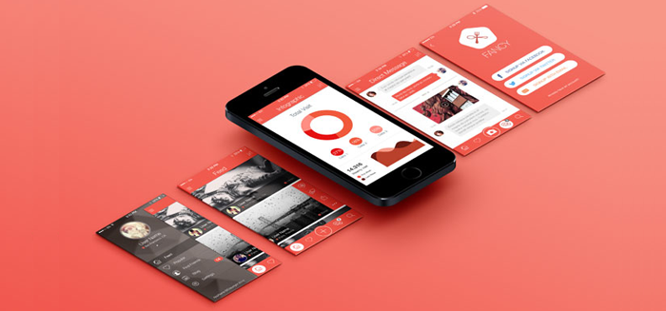
Advantages of setting up an app
Advantages of setting up an app
http://fpt.edu.vn

Slide 9
Steps to design app
• The primary responsibilities of UX professionals may include but are not limited to:
Performing user research;
Creating user personas;
Identifying the information architecture of an application;
Designing user flows and wireframes;
Creating prototypes;
Performing user testing.
http://fpt.edu.vn

Slide 10
A typical set of tasks for UI designers can include
Transforming requirements into style guides and attractive interfaces;
Identifying design problems and finding effective solutions;
Creating animations;
Choosing fonts and color palettes;
Designing UI elements like scrollbars and icons.
http://fpt.edu.vn

Slide 11
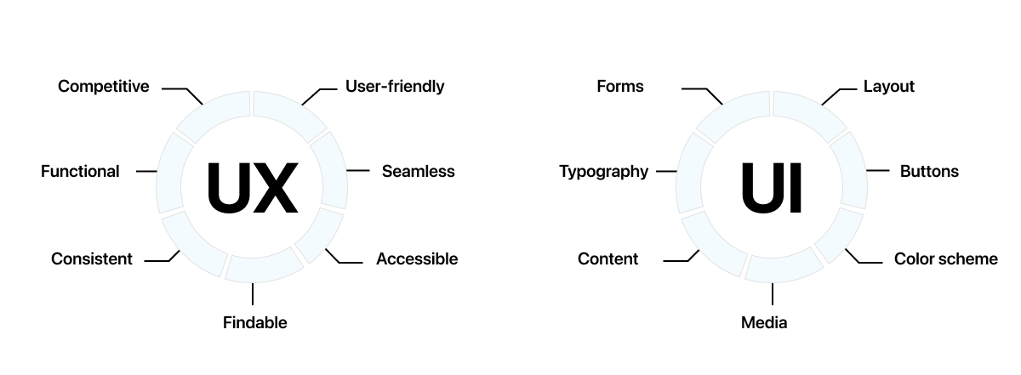
As you can see, UI and UX are the two sides of the same coin, as both lead to a better product experience. Therefore, it is essential to pay due diligence to each during the design process.
http://fpt.edu.vn

